Slide 1

Financial Services Data Model
Module 3
Notes:
Welcome to the next module in Microsoft Cloud for Financial Services in a day

Slide 2





Know the Solution
What is the Microsoft Common Data Model (CDM)
GitHub view of the Financial Services CDM
Deep dive into FSI Data Model layers
Entity Relationship diagram walkthrough
Financial Services Data Model extensibility
Notes:
In this module, we will cover-
What is the Microsoft Common Data Model also known as the CDM?
Then we will have a look at the open source github view of the CDM with FSI constructs
We will also deep dive into the FSI solution layering and understand how the FSI data model is positioned with respect to each of the FSI capabilities
Then we will cover a detailed entity relationship diagram walkthrough for the FSI schema
And before we close, we will go through the CDM extensibility mechanisms that can be used to build customizations on top of the FSI solutions

Slide 3








Microsoft Common Data Model
Ease interoperability and unify data to help accelerate insights and business workflows
Dynamics 365
Microsoft 365
Power Platform
ISV Solutions
A common machine-understandable way to
describe data with semantic consistency across business, transactional, analytical and industry domains that drives interoperability across apps and services from the Microsoft ecosystem, and customers to create insights
Dataverse
Azure Synapse
Common Data Model
Notes:
So let us first understand what is the Microsoft Common Data Model or CDM?
If you've ever had to bring data from multiple systems and applications together, you know what an expensive and time-consuming task that can be. Without being able to share and understand the same data easily, each application or data integration project requires a custom implementation.
Common Data Model simplifies this process by providing a shared data language for business and analytical applications to use. Simply put, it is a common, machine understandable way to describe data so that your apps and services can understand and operate off of a shared set of semantics.
Now the Common Data Model is not a service itself. It is a semantically rich set of table and column definitions that can be instantiated as a service.
For Business data, CDM is instantiated through Dataverse (formerly known as Common Data Service). Customers, Partners and ISVs can use and extend the entity-attribute definitions as needed in order to access and write business data resident in Dataverse. This includes Finance, Operations, Customer and other data being created by the Business Applications.
For analytical data, CDM is instantiated through Azure Synapse. Customers and Partners can use Azure Synapse to manage and extend CDM definitions, and to create new entity definitions as needed.

Slide 4
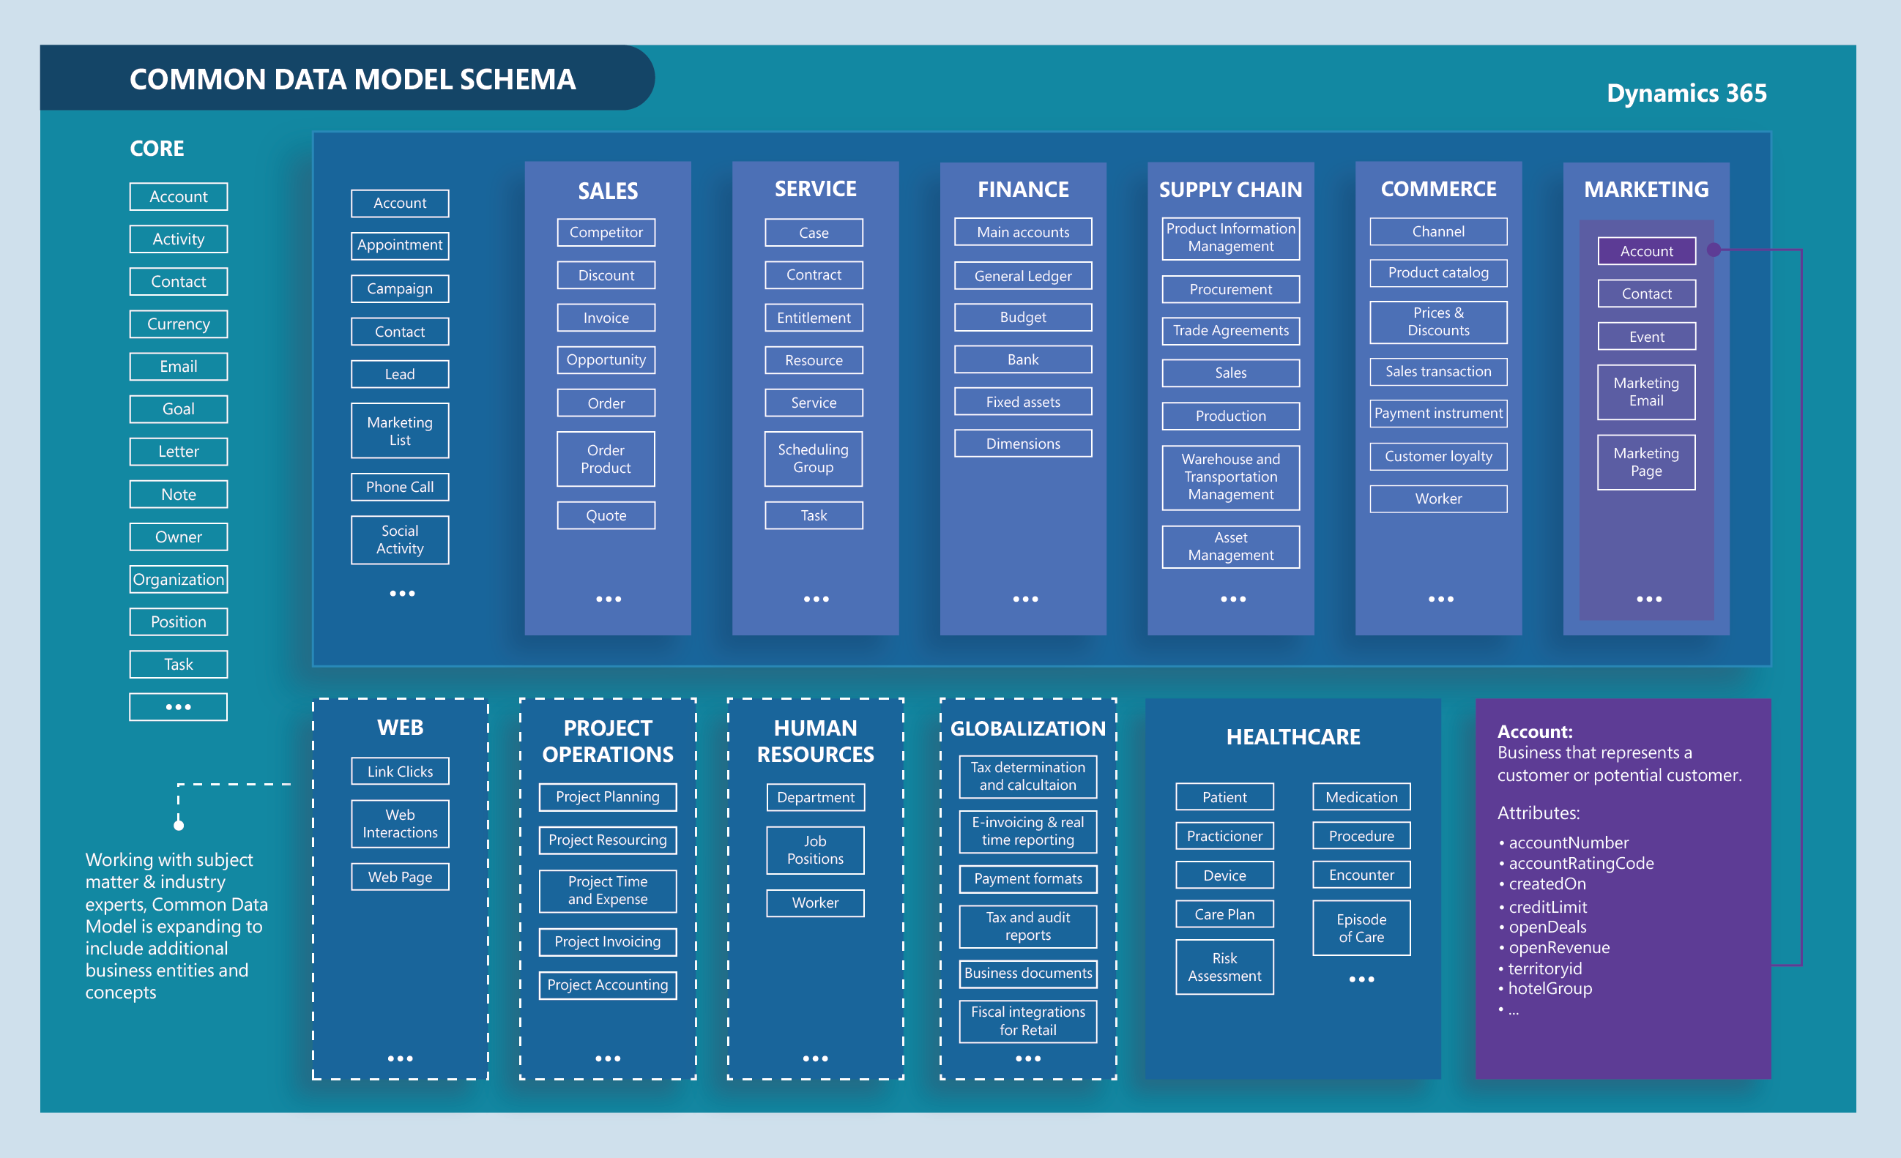
Common Data Model schema
Ease interoperability and unify data to help accelerate insights and business workflows
Notes:
Microsoft Common Data Model sits in the heart of our Data Platform strategy. It includes a set of standardized, extensible data schemas that Microsoft and its partners have published. This collection of predefined schemas includes entities, attributes, semantic metadata, and relationships. The schemas represent commonly used concepts and activities, such as Accounts, Contacts, Banks and Financial Holdings, to simplify the creation, aggregation, and analysis of financial data.
A shared schema layer helps accelerate application development, analytics, and data integrations for both operational and analytical scenarios.
The merge of the FSI data model into Microsoft Common Data Model is in progress and should be available in the next couple weeks. Once ready, we will be able to browse to the github version of the CDM and be able to view the elements of the standard tables with the FSI Data Model<here> in conjunction with the overall Microsoft Common data Model schema.

Slide 5
Microsoft Cloud for Financial Services Data model
Ease interoperability and unify data to help accelerate insights and business workflows
Customer schema
Example retail banking schemas
Industry specificity
Leverage a common data model with financial services-specific semantics
Branch schema
Loan application
Interoperability
Data model allows to ingest, enrich, and unify data to break down data silos and ease interoperability through industry specific pre-built connectors
Loan application schema
Applications
Assets
Loan details
Liabilities
Groups and relationships schema
Collateral
Credit check
Faster innovation
Extend the value of the platform with additional solutions, analytics, and predictions
KYC
Life events schema
Employment
Financial holdings schema
Notes:
Microsoft cloud for Financial Services data model eases interoperability and unifies data to help accelerate insights and business workflows.
It offers
Industry specificity to leverage a common data model with financial services-specific semantics
It also helps ingest, enrich, and unify data to break down data silos and ease interoperability through industry specific pre-built connectors
And by virtue of being able to extend the platform, it allows for Faster innovation with additional solutions, analytics, and predictions
On the right, you can see retail banking elements that are part of our industry data model, such as customer schema, branch schema, and loan application schema. Within each of these schemas are defined tables, attributes and relationships. For example, within loan application schema, there are loan details, assets, liabilities, credit check, and more. We will cover them in detail as we go over the ER diagram later.

Slide 6


Data Model layers
Solutions using the layer
Model layer
Key tables
Unified customer profile
Customer onboarding
Collaboration manager
Banking customer engagement
Financial services common data model
Contact
Bank
Branch
Group
Group Member
Application/custom document
Retail banking core data model
Financial holdings
Financial holding instruments
Customer financial holding
Life events
Group financial holdings
Loan onboarding data model
Loan application
Loan application contact
Collateral
Credit check
Employment
KYC
Notes:
The FSI data model is bifurcated into three layers – Financial services common data model, Retail banking core data model and the Loan onboarding data model.
Each of these data model layers are then leveraged in the solutions or capabilities that FSI includes.
Financial services common data model layer cuts across all solutions and you will see it show up accordingly <here>. Similarly, you can note that unified customer profile uses the financial services common data model aswell as the retail banking core data model underneath. And customer onboarding and collaboration manager are built atop financial services common data model and loan onboarding data model together. This information comes handy during implementation for identifying the solution dependency on the data model layers.

Slide 7
Data Model in Cloud for Financial Services
Notes:
Now that we saw what exactly the FSI CDM comprises of, lets see how it positions itself in the overall Financial Services cloud.

Slide 8











Relationship Manager
Relationship Manager
Customer Service Agent
Customer
Customer
Loan Specialist
Relationship Manager
Loan Specialist
Unified Customer Profile
Banking Customer Engagement
Customer onboarding
Collaboration manager
Power Apps
Customer Retail Banking Controls
Customer snapshot
Connections
Life Events
Financial Holdings
Dynamics 365 Omnichannel for Customer Service
Sample Power Apps Portal
Microsoft Teams
Loan tracker app
Power Apps
Collaboration Manager – Model Driven App
Power Apps
Customer Retail Banking Controls
Customer snapshot
Life Events
Financial Holdings
Power Apps
Application snapshot & verification
Financial strength snapshot
Loan Application doc management
Collaboration PCF controls
Dynamics 365 Customer Insights
Dataverse
Loan Application Plugins
Loan Application Business Process
Collaboration Toolkit DM
Microsoft Graph
Customer Intelligence
FSI Segments
FSI Prediction (FSI Churn)
FSI Measures
FSI Core Retail Banking Plugins
FSI CI Entities
Loan Application Mgmt Logic
Document Rule Engine
Key
Microsoft 365
Microsoft Cloud for Financial Services
CI Data Store and Retail Banking Entities
Retail Banking Core Data Model
Loan Onboarding Data Model
Planner
Bookings
SharePoint
Outlook
Microsoft Product
Banking Environment
Financial Services Common Data Model
Customization
✦✦
Bank Schema 2 FSI CDM
Non-Customer Experience optional data
Customer Experience data (CIF+)
Additional Bank Data Sources
Banking Core Compute
Notes:
The core data constructs, that is the data model for FSI lies in these layers <point to red layer>. It acts as the entry point for Banking core compute data that needs to be mapped to the FSI schema to be able to view the FSI experiences. This is also the connectivity point to non customer experience data that comes in from the analytical or intelligence based systems making it a true single ground for all engagement experiences. As long as the banking data is represented in the FSI data model format, the experiences such as Unified customer profile, Customer onboarding etc. light up on their own.
Now we will have a look at the different data model layers and view the table structures beneath.

Slide 9
Financial Services Common Data Model
Table | Description
Account | Business that represents a customer or potential customer. The company that is billed in business transactions.
Applicationdocument | Document filled out by a potential borrower to apply for a loan; provides financial and other information to the lender.
Bank | The bank that the branch is associated with.
Branch | The branch of the main bank, when borrower applies for a loan at a branch.
Contact | Person with whom a business unit has a relationship, such as customer, supplier, and colleague.
Customdocument | Any document that is requested by or accepted by the bank, e.g. for the borrower's loan application.
Group | An association of several customers allowing e.g. the representation of households
Groupmember | An association between a customer and a Group.

Slide 10
Retail Banking Core Data Model
Table | Description
Account | Business that represents a customer or potential customer. The company that is billed in business transactions.
Bank | The bank that the branch is associated with.
Branch | The branch of the main bank, when borrower applies for a loan at a branch.
Contact | Person with whom a business unit has a relationship, such as customer, supplier, and colleague.
Customerfinancialholding | Financial holdings owned by the customer.
Fh_account | A deposit account holding that allows the holder to make deposits and withdrawals through financial holding instruments. An account can be interest bearing.
Fh_creditline | A preset borrowing limit associated with a credit or charge card.
Fh_investment | A holding representing a portfolio of securities or other investible assets.
Fh_loan | Loans held by the customer with the financial institution.
Fh_saving | Savings accounts held by the customer at the financial institution.
Financialholding | Accounts, loans, investments, credit lines and savings accounts held by a customer.

Slide 11
Retail Banking Core Data Model
Table | Description
Financialholdinginstrument | Financial tools associated with financial holdings; a monetary contract between parties which has intrinsic monetary value or transfers value. Provides an efficient flow and transfer of capital.
Fi_card | A payment card issued by a bank to an account holder enabling the account holder to make payments or purchases, paying back the balance to the issuing bank, plus interest.
Fi_directdebit | An automated payment system whereby an account holder authorizes a creditor to debit the customer's bank account at regular intervals.
Fi_overdraft | An extension of credit associated with a checking account allowing the account holder to continue withdrawing funds when an account reaches zero.
Fi_standingorder | An instruction order from an account holder for a set amount of money to be removed from an account at regular intervals and paid to or transferred to another account.
Group | An association of several customers allowing e.g. the representation of households.
Groupfinancialholding | Financial holdings associated with a Group, to be included in the group's total assets and liabilities.
Groupmember | An association between a customer and a Group.
Lifemoment | Significant milestones in a customer's personal life which can impact their financial situation, such as attending college, marriage, having a child, retirement, etc.
Relationship | Denotes an association between one contact to another (not as part of the larger group) where there is not necessarily a direct association of finances. For example, a spouse, lawyer, child or grandparent.

Slide 12
Loan Onboarding Common Data Model
Table | Description
Applicationdocument | Document filled out by a potential borrower to apply for a loan; provides financial and other information to the lender.
Bank | The bank that the branch is associated with.
Collateral | An asset that a lender accepts as security for a loan.
Contact | Person with whom a business unit has a relationship, such as customer, supplier, and colleague.
Creditcheck | A process of checking the customer's financial history and financial behavior.
Customdocument | Any document that is requested by or accepted by the bank, e.g. for the borrower's loan application.
Employment | Describes the loan contact's job or place of work, or work history.
Kyc | Reference to Know Your Customer entity.
Loanapplication | Document filled out by a potential borrower to apply for a loan; provides financial and other information to the lender.
Loanapplicationasset | Asset associated with the loan application.
Loanapplicationcollateral | Collateral associated with the loan application.
Loanapplicationcollateralvaluation | Valuation associated with a collateral of the loan application.
Loanapplicationcontact | The customer associated with the loan application.
Loanapplicationcontactasset | Application contact associated with the application asset.
Loanapplicationcontactliability | Application contact associated with the application liability.
Loanapplicationliability | Liability associated with the loan application.

Slide 13
Entity Relationship Diagram walkthrough

Slide 14
Financial Services Data Model extensibility
Notes:
With this, we now move to the Financial Services Data Model extensibility and how our partners play a pivotal role in enabling the industry cloud transformations

Slide 15
How partners enable Microsoft Cloud for Financial Services
Implement
Extend
Amplify
Facilitate integration of Microsoft Cloud for Financial Services specific to each customer’s needs and environment
Partner Offering/IP extend current Capabilities; or extending into new markets
Evangelize the value to Boards, C-Suite and LOB
Services
ISV Apps
Advisory
Notes:
The power of Microsoft Cloud for Financial Services doesn’t stop with our first-party technologies and solutions. Our partners are instrumental to its success and scalability.
Microsoft Cloud for Financial Services offers a vast array of interoperable building blocks designed to solve problems unique to the financial services industry. Microsoft’s growing ecosystem of Services and ISV partners extend the robust cloud capabilities of the Microsoft Cloud for Financial Services. Partners can implement, extend and amplify the solutions available in the Microsoft Cloud for Financial Services to customize or augment what a customer would experience out of the box. Partners can also create new and differentiated experiences using these building blocks.
The industry data model further empowers partners to support shared customers through interoperability across applications. It also encourages partners to consume, enrich, and surface the data available to customers in Microsoft Cloud for Financial Services to make their experiences richer and more relevant.
Cloud for FSI also helps customers with security and compliance requirements. We enrich the value of our cloud by asking our partners to adhere to industry relevant security and compliance standards and will benefit from inherited platform controls built in to meet customer demand.

Slide 16

CDM Extensibility – Solution Delivery Models
Customers
SIs: Deliver and customize applications on our cloud for the customer.
SI
SI
AppSource/Azure Marketplace: Delivery mechanism for Industry Solutions and/or Apps and Microsoft Solution Clouds
AppSource - Azure Marketplace
3rd Party & OOB Connectors
Industry ISVs: Provide applications which require specialized industry knowledge to build, such as regulatory restrictions or industry processes
Industry ISV
Industry ISV
Industry ISV
Horizontal ISVs: Provide applications which target business processes common to many industries
Horizontal ISV
Horizontal ISV
Microsoft Industry Cloud Models
Microsoft Industry Solution Clouds: package of data model, relevant business processes, Power BI, AI, M365, Teams Integrations and sample data built on top of Microsoft Azure
Microsoft Base CDM Models
Notes:
FSI comes prebuilt with many functionalities out of the box. And for where we need to customize, there is the extension mechanism.
Microsoft Industry Solution Clouds package the data model along with the relevant business processes, Power BI, AI, M365, Teams Integrations and sample data built on top of Microsoft Azure. And hence there is the flexibility to extend these components at each layer. If you intend to extend the FSI solution, there are multiple solution delivery mechanisms.
If you are a Horizontal ISVs <point to light blue> you provide applications which target business processes common to many industries and can build upon one or more industry clouds data models.
If you are an Industry ISV <point to yellow> or customer that cater to a specific industry like healthcare, you can start building right on top of the data model and extend vertical or micro-vertical scenarios. Such as – build an advanced KYC workflow in FSI
If you also intend to publish your solutions and reach out to your customers, we have the delivery mechanism for Industry solutions in AppSource and Azure Marketplace.
And if you are an SI, then you have the possibility of bring in the IP from multiple ISVs and surface for your customers.
In essence, irrespective of the capacity you engage with Microsoft in, you can extend and leverage the multiple solution delivery models and bring in value to your customers.

Slide 17
Financial Services Data Model extensibility
Notes:
With this, we now move to the Financial Services Data Model extensibility and how our partners play a pivotal role in enabling the industry cloud transformations

Slide 18

Lab Resources
GitHub: Lab documents and Resources
https://aka.ms/mc4fslabs

